Slide 1


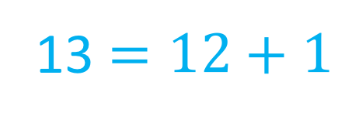
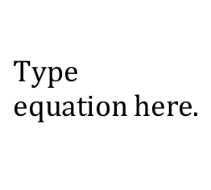
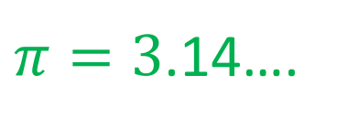
My Number Interactive Notebook
$$0$$
$π=3$.14….
$$\frac{5}{6}$$
Name :
Class :
Term 2 Semester 1
13 $=12+1$

Slide 2
Contents
Glossary
Page
Date
Description
2
3

Slide 3
Tasks
24
7
30
Essential Question
Questions
Notes
Summary
4
5

Slide 4
24
7
30
Date
Rational Numbers
EQ – How do we show that a number is rational?
What is a rational number?
A rational number is one which can be expressed as a ratio (or fraction) where the numerator and denominator are integers
5
Notes:
People are sometimes described as rational or acting rationally/irrationally… what does that imply?

Slide 5

24
7
30
Date
Rational Numbers
EQ – How do we show that a number is rational?
What is a rational number?
A rational number is one which can be expressed as a ratio (or fraction) where the numerator and denominator are integers
Eg 5 is rational because it can be written as $\frac{5}{1}$
Can you show that -13 is a rational number?
5

Slide 6
Game- Which rational number is bigger?
Hold up your right hand if the right integer is larger, or your left arm if the left is bigger?
Every correct answer is worth a point
The first hand up with the correct answer gets a bonus point
Make sure you record your score!

Slide 7
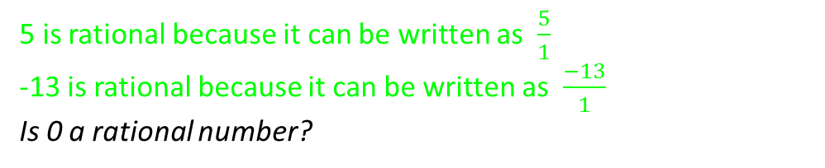
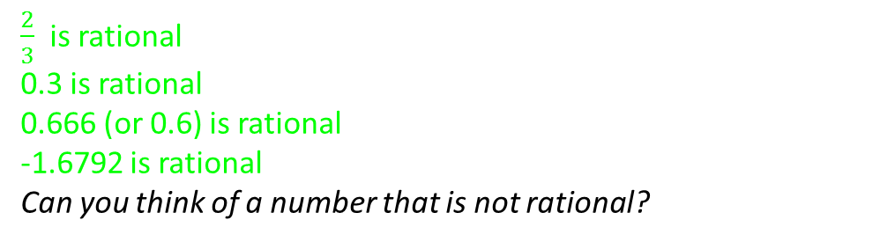
24
7
30
Date
Rational Numbers
EQ – How do we show that a number is rational?
What is a rational number?
A rational number is one which can be expressed as a ratio (or fraction) where the numerator and denominator are integers
5 is rational because it can be written as $\frac{5}{1}$
-13 is rational because it can be written as $\frac{−13}{1}$
Is 0 a rational number?
How are rational numbers expressed?
Rational numbers can be written as integers, fractions or decimals.
$\frac{2}{3}$ is rational
0.3 is rational
0.666 (or 0.6) is rational
-1.6792 is rational
Can you think of a number that is not rational?
5

Slide 8
Which rational number is bigger?
643 1005

Slide 9
Which rational number is bigger?
10 -15

Slide 10
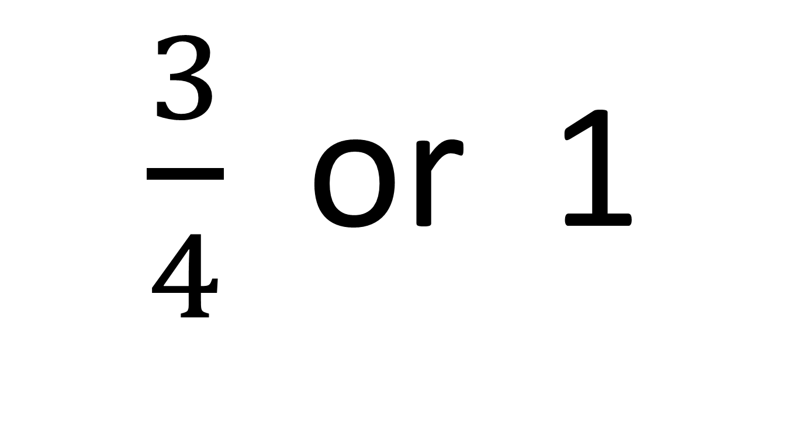
Which rational number is bigger?
$\frac{3}{4}$ or 1

Slide 11
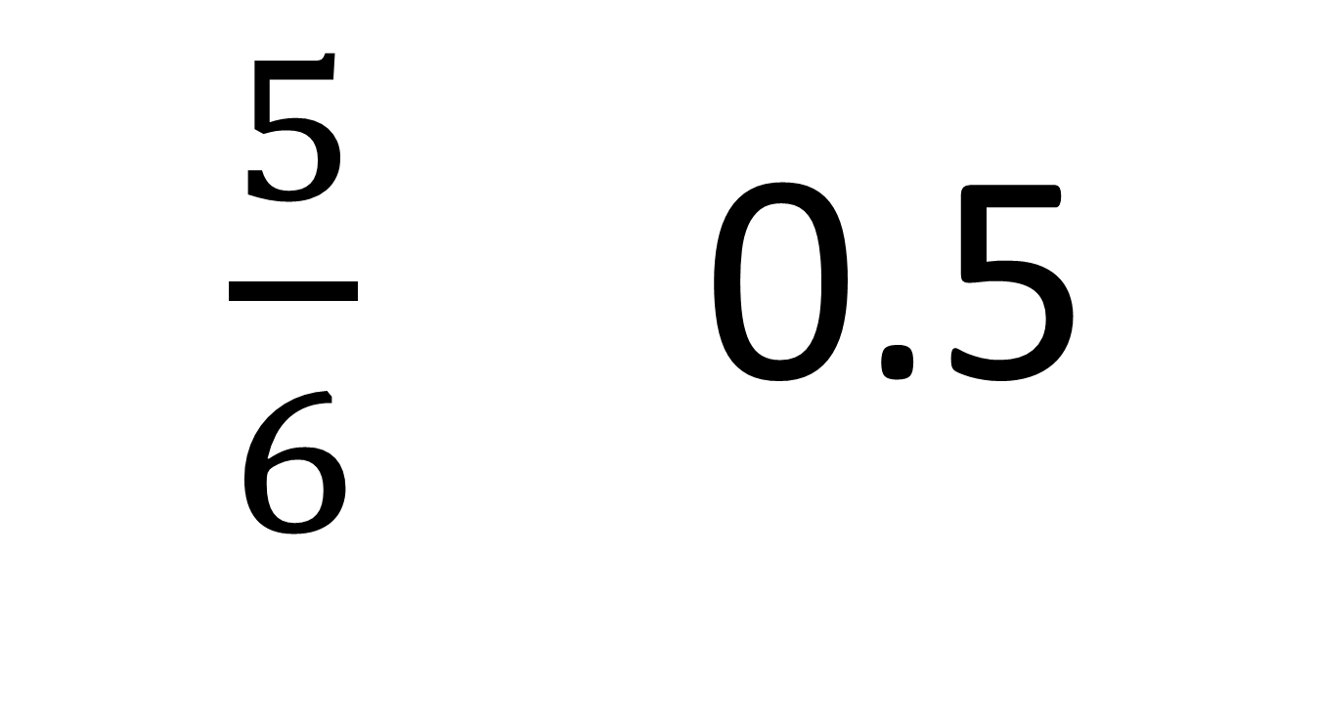
Which rational number is bigger?
$\frac{5}{6}$ 0.5

Slide 12
Which integer is bigger?
-99 0
Notes:
Zero of anything is bigger than a negative amount!

Slide 13
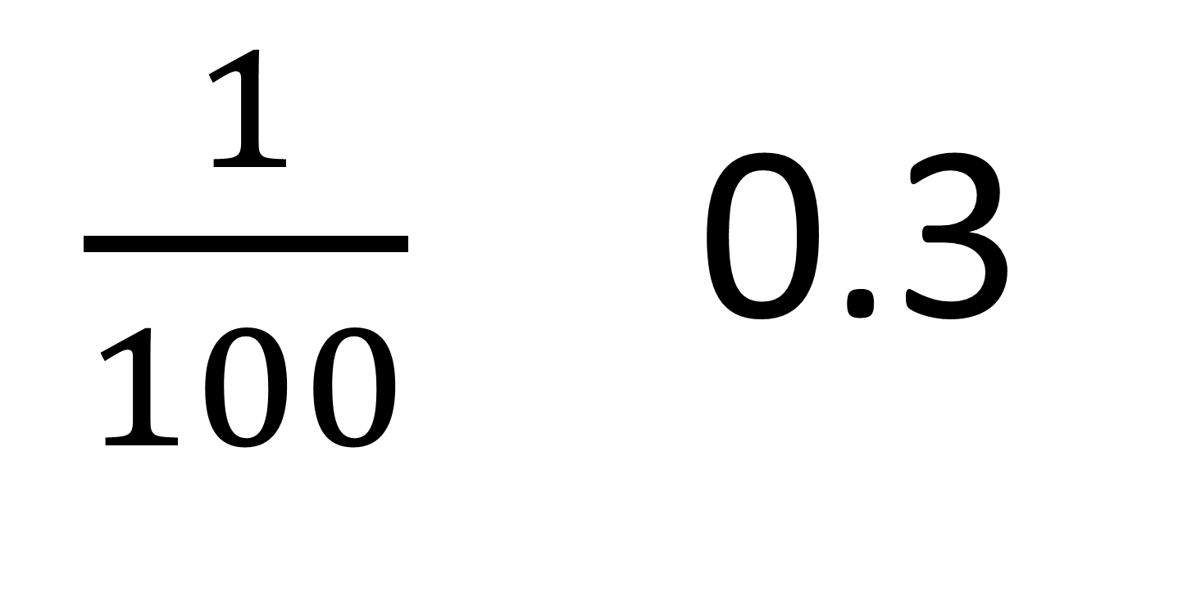
Which rational number is bigger?
$\frac{1}{100}$ 0.3
Notes:
0.01 vs 0.3

Slide 14
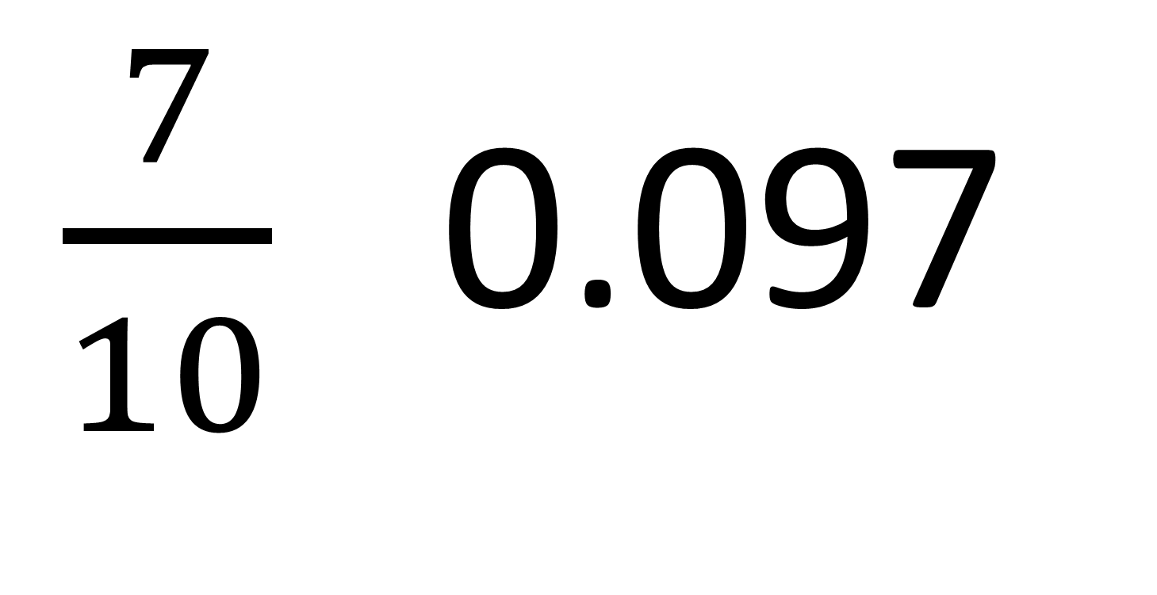
Which rational number is bigger?
$\frac{7}{10}$ 0.097

Slide 15

Which rational number is bigger?
$\frac{1}{3}$ -5

Slide 16

Task- Order these rational numbers
5 , -5 , 2 , 0 , -2 , $\frac{2}{5}$
$\frac{2}{3}$ , 2 , 0.2 , 0 , -3 , $\frac{1}{3}$
-4 , 40 , 0 , $\frac{1}{4}$ , -0.4 , $\frac{1}{40}$
0.9 , $\frac{99}{100}$ , 0 , 1.09 , 1 , -0.9

Slide 17
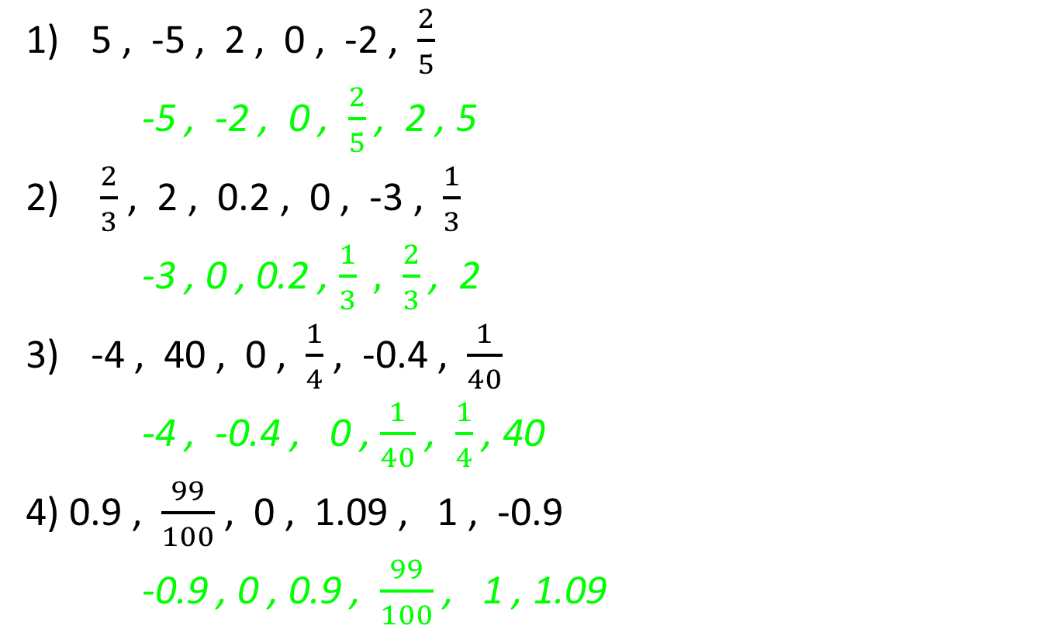
ANSWERS- Order these rational numbers
5 , -5 , 2 , 0 , -2 , $\frac{2}{5}$
-5 , -2 , 0 , $\frac{2}{5}$ , 2 , 5
$\frac{2}{3}$ , 2 , 0.2 , 0 , -3 , $\frac{1}{3}$
-3 , 0 , 0.2 , $\frac{1}{3} , \frac{2}{3}$ , 2
-4 , 40 , 0 , $\frac{1}{4}$ , -0.4 , $\frac{1}{40}$
-4 , -0.4 , 0 , $\frac{1}{40}$ , $\frac{1}{4}$ , 40
4) 0.9 , $\frac{99}{100}$ , 0 , 1.09 , 1 , -0.9
-0.9 , 0 , 0.9 , $\frac{99}{100}$ , 1 , 1.09

Slide 18
Irrational Numbers
So when is a number irrational?
When it is emotional? Or A non-terminating or non-recurring decimal that cannot be written as a proper fraction.
Can you think of one?
Try Pi…(Pi & sauce poster) or square root of 2?

Slide 19
Notes Review
24, 7 ,30
Date
Title
Essential question
Notes complete
Notes complete with colour and diagrams
Questions completed
Contents page filled in
Formula page filled in

Slide 20
Homework
Review your notes and write a summary answering the essential question.

